Slide 1
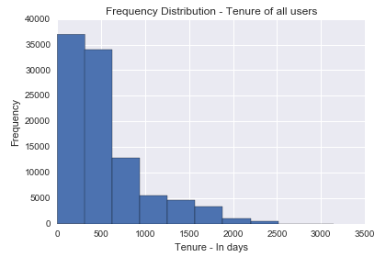
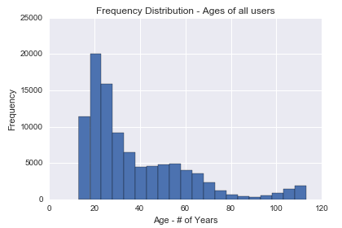
Frequency – By Tenure & By Age
Basic Analysis V
Frequency Polygon by Tenure
Observation:
Data contains majority of users joined in last couple of years (~77%)
This could be attributed to technological transformation and MobileFirst strategy where more and more users are using Mobile and hence Facebook is easily accessible.
And/Or, can it be attributed to social change ?
Frequency Polygon by Age
Observation:
Majority of users are of early 20 age and more the age frequency is declining
Quite surprisingly frequency increases after 90 which raises sanctity of data of 90+ aged users. However further analysis needed to conclude that

